Slide 1




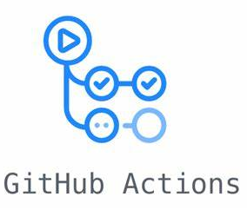







M5-G1-lambda-exec-uuid
314146336986.dkr.ecr.us-east-1.amazonaws.com/gruppo1
AWS Step Functions
M5-G1-Repo
SageMaker DataProcessingJob
M5-G1-lambda-trigger
s3://data-remote-repository-cefriel/gruppo-1/processed/
SageMaker TrainingJob
M5-G1-lambda-ingestion
s3://data-remote-repository-cefriel/gruppo-1/model/
SageMaker EndPointPublisherJob
s3://data-remote-repository-cefriel/gruppo-1/raw/
M5-G1-EB-Ingestion-shedule
cron(0 7 ? * 1 *)
Cloud Watch Log
s3://data-remote-repository-cefriel/gruppo-1/outputs/
TBD
SageMaker EndPointTesterJob
Cloud Watch Alarm
M5-G1-sfjobswaterfall

